Slide 1


Database Concepts

Slide 2
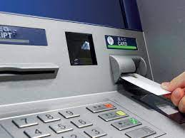








Databases that you may use…..

Slide 3
Data
Data
A necessity for almost any enterprise to carry out its business. Consists of raw facts, and when organized may be transformed into information
Database
A collection of data organized to meet users’ needs
Database management system (DBMS)
A group of programs that manipulate the database and provide an interface between the database and the user of the database or other application programs

Slide 4

DBMS ‘Discussion’
A collection of programs that enables you to store, modify, and extract information from a database. There are many different types of DBMSs, ranging from small systems that run on personal computers to huge systems that run on mainframes. The following are examples of database applications:
computerized library systems
automated teller machines
flight reservation systems
computerized parts inventory systems

Slide 5
Hierarchy of Data

Slide 6
Basics of Data Arrangement and Access
The Data Hierarchy
Recall…8 bits => 1 byte => 1 character
Field - a logical grouping of characters into a word, a small group of words, or a complete number
Record - a logical grouping of related fields
File - a logical grouping of related records
Database - a logical grouping of related files

Slide 7
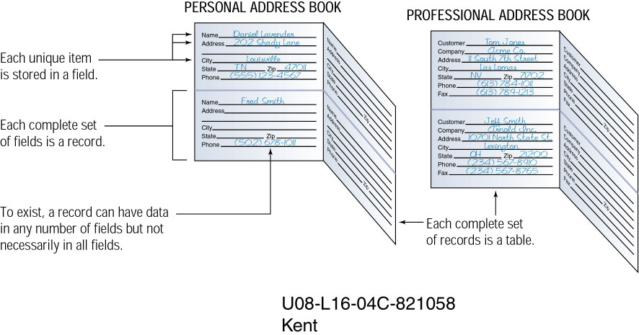
Field
Record

Slide 8
PROFESSIONAL ADDRESS BOOK
File/Table

Slide 9
The Hierarchy of Data
Hierarchy of data
Example
Database
Personel file
Department file
(Project database)
Payroll file
Files
005-10-6321 Johns Francine 10-7-65
549-77-1001 Buckley Bill 2-17-79
098-40-1370 Fiske Steven 1-5-85
(Personnel file)
Records
098-40-1370 Fiske Steven 1-5-85 598
(Record containing SSN, last name, first name, date of hire)
Fields
Fiske
(Last name field)
Characters (bytes)
1000100
(Letter ‘F’ in ASCII)

Slide 10
Data Entities, Attributes, and Keys
Entity
A generalized class of people, places, or things (objects) for which data are collected, stored, and maintained
E.g., Customer, Employee
Attribute
A characteristic of an entity; something the entity is identified by
E.g., Customer name, Employee name
Keys
A field or set of fields in a record that is used to identify the record
E.g, A field or set of fields that uniquely identifies the record

Slide 11
Keys and Attributes
Employee # | Last name | First name | Hire date | Dept. #
005-10-6321 | Johns | Francine | 10-7-65 | 257
549-77-1001 | Buckley | Bill | 2-17-79 | 650
098-40-1370 | Fiske | Steven | 1-5-85 | 598
Key field
Entities (records)
Attributes (fields)

Slide 12
The Traditional Approach
The traditional approach…
Separate files are created and stored for each application program
Schematic

Slide 13
Application
programs
Data
Files
Users
Payroll
Payroll programs
Reports
Invoicing
Invoicing programs
Reports
Inventory control
Inventory control programs
Reports
Management inquiries
Management inquiries programs
Reports

Slide 14
Drawbacks
Data redundancy
Duplication of data in separate files
Lack of data integrity
The degree to which the data in any one file is accurate
Program-data dependence
A situation in which program and data organized for one application are incompatible with programs and data organized differently for another application

Slide 15

Database Approach
The database approach…
A pool of related data is shared by multiple application programs
Rather than having separate data files, each application uses a collection of data that is either joined or related in the database
Schematic

Slide 16
Payroll
program
Reports
Payroll data
Inventory data
Invoicing
Data
Other data
Inventory
program
Reports
Database
management
system
Invoicing
program
Reports
Other
programs
Reports
Database
Interface
Applications programs
Users

Slide 17

Database Management System (DBMS)
DBMS contains information about a particular enterprise
Collection of interrelated data
Set of programs to access the data
An environment that is both convenient and efficient to use
Database Applications:
Banking: all transactions
Airlines: reservations, schedules
Universities: registration, grades
Sales: customers, products, purchases
Online retailers: order tracking, customized recommendations
Manufacturing: production, inventory, orders, supply chain
Human resources: employee records, salaries, tax deductions
Databases touch all aspects of our lives

Slide 18
Purpose of Database Systems
In the early days, database applications were built directly on top of file systems
Drawbacks of using file systems to store data:
Data redundancy and inconsistency
Multiple file formats, duplication of information in different files
Difficulty in accessing data
Need to write a new program to carry out each new task
Data isolation — multiple files and formats
Integrity problems
Integrity constraints (e.g. account balance > 0) become “buried” in program code rather than being stated explicitly
Hard to add new constraints or change existing ones

Slide 19
Drawbacks of using file systems (cont.)
Atomicity of updates
Failures may leave database in an inconsistent state with partial updates carried out
Example: Transfer of funds from one account to another should either complete or not happen at all
Concurrent access by multiple users
Concurrent accessed needed for performance
Uncontrolled concurrent accesses can lead to inconsistencies
Example: Two people reading a balance and updating it at the same time
Security problems
Hard to provide user access to some, but not all, data
Database systems offer solutions to all the above problems

Slide 20

Why Use a DBMS?
Data independence and efficient access.
Reduced application development time.
Data integrity and security.
Uniform data administration.
Concurrent access, recovery from crashes.
Notes:
3

Slide 21
Levels of Abstraction
Physical level: describes how a record (e.g., customer) is stored.
Logical level: describes data stored in database, and the relationships among the data.
type customer = record
customer_id : string; customer_name : string; customer_street : string; customer_city : integer;
end;
View level: application programs hide details of data types. Views can also hide information (such as an employee’s salary) for security purposes.

Slide 22
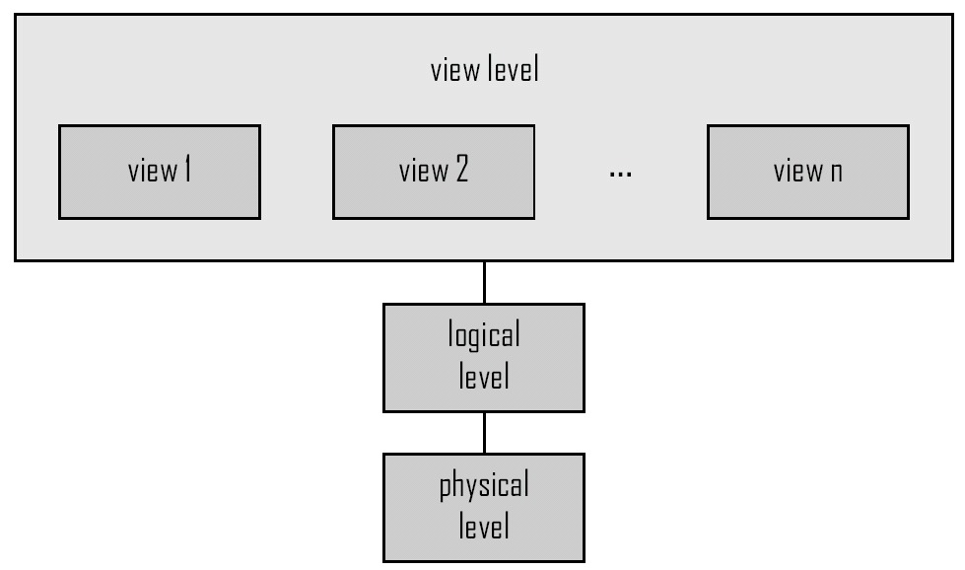
View of Data
An architecture for a database system

Slide 23
Instances and Schemas
Similar to types and variables in programming languages
Schema – the logical structure of the database
Example: The database consists of information about a set of customers and accounts and the relationship between them)
Analogous to type information of a variable in a program
Physical schema: database design at the physical level
Logical schema: database design at the logical level
Instance – the actual content of the database at a particular point in time
Analogous to the value of a variable
Physical Data Independence – the ability to modify the physical schema without changing the logical schema
Applications depend on the logical schema
In general, the interfaces between the various levels and components should be well defined so that changes in some parts do not seriously influence others.

Slide 24
Database Design
The process of designing the general structure of the database:
Logical Design – Deciding on the database schema. Database design requires that we find a “good” collection of relation schemas.
Business decision – What attributes should we record in the database?
Computer Science decision – What relation schemas should we have and how should the attributes be distributed among the various relation schemas?
Physical Design – Deciding on the physical layout of the database

Slide 25
Data Models
A collection of tools for describing
Data
Data relationships
Data semantics
Data constraints
Relational model
Entity-Relationship data model (mainly for database design)
Other models
Object-based data models (Object-oriented and Object-relational)
Semi-structured data model (XML)
Other older models:-
Network Model
Hierarchical Model

Slide 26
Database Languages
Data Definition Language
Data Manipulation Language
Data Control Language

Slide 27
Data Definition Language (DDL)
Specification notation for defining the database schema
Example: create table account ( account-number char(10), balance integer)
DDL compiler generates a set of tables stored in a data dictionary
Data dictionary contains metadata (i.e., data about data)
Database schema
Data storage and definition language
Specifies the storage structure and access methods used
Integrity constraints
Domain constraints
Referential integrity (references constraint in SQL)
Authorization

Slide 28
Data Manipulation Language (DML)
Language for accessing and manipulating the data organized by the appropriate data model
DML also known as query language
Two classes of languages
Declarative (nonprocedural) – user specifies what data is required without specifying how to get those data, expresses the logic of a computation without describing its control flow. It attempts to minimize or eliminate side effects by describing what the program should accomplish, rather than describing how to go about accomplishing it.
Procedural – user specifies what data is required and how to get those data
SQL is the most widely used query language

Slide 29
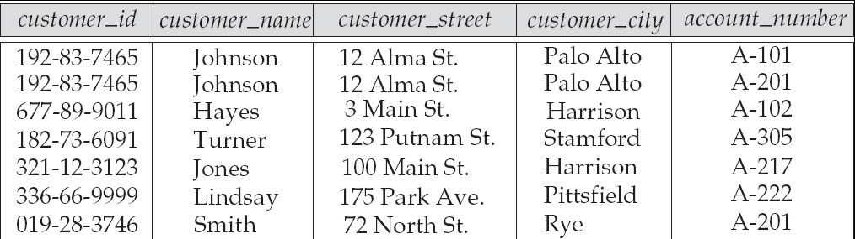
Relational Model
Attributes
Example of tabular data in the relational model

Slide 30
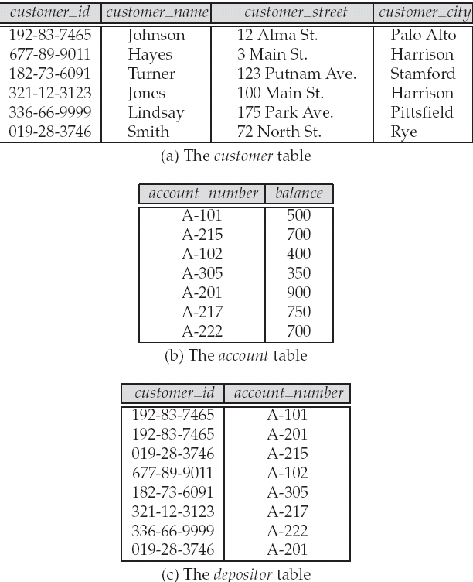
A Sample Relational Database

Slide 31
SQL
SQL: widely used non-procedural language
Example: Find the name of the customer with customer-id 192-83-7465 select customer.customer_name from customer where customer.customer_id = ‘192-83-7465’
Application programs generally access databases through one of
Language extensions to allow embedded SQL
Application program interface (e.g., ODBC/JDBC) which allow SQL queries to be sent to a database

Slide 32
Transaction Management
A transaction is a collection of operations that performs a single logical function in a database application
Transaction-management component ensures that the database remains in a consistent (correct) state despite system failures (e.g., power failures and operating system crashes) and transaction failures.
Concurrency-control manager controls the interaction among the concurrent transactions, to ensure the consistency of the database.
Notes:
32

Slide 33
Architecture of Database Applications
Database applications are usually partitioned into two or three parts
Two-tier architecture -- the application resides at the client machine, where it invokes database system functionality at the server machine
Three-tier architecture -- the client machine acts as a front end and does not contain any direct database calls.
The client end communicates with an application server, usually through a forms interface.
The application server in turn communicates with a database system to access data.
Notes:
33

Slide 34
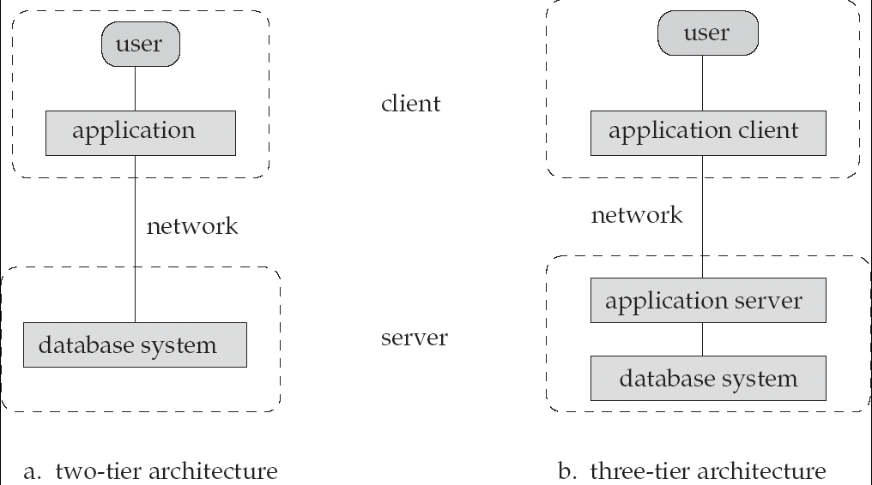
Architecture

Slide 35
Database Users
Users are differentiated by the way they expect to interact with the system
Database Administrators
Application programmers – interact with system through DML calls
Sophisticated users – form requests in a database query language
Naïve users – invoke one of the permanent application programs that have been written previously
Examples, people accessing database over the web, bank tellers, clerical staff

Slide 36
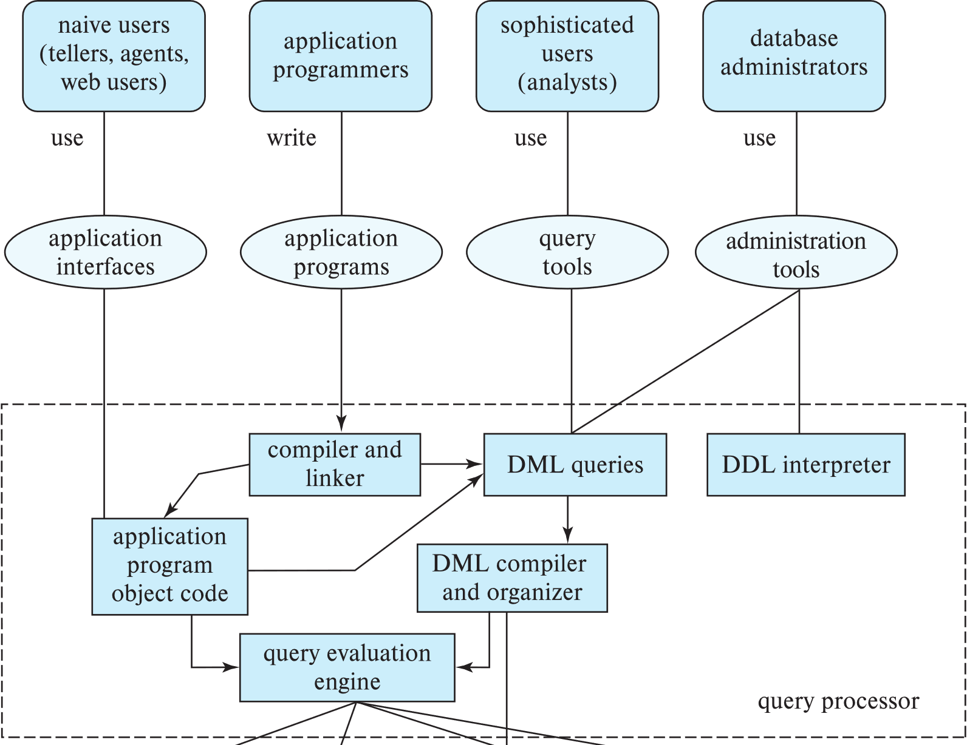
Database Users
Notes:
36

Slide 37
Database Administrator
Coordinates all the activities of the database system; the database administrator has a good understanding of the enterprise’s information resources and needs.
Database administrator's duties include:
Schema definition
Storage structure and access method definition
Schema and physical organization modification
Granting user authority to access the database
Specifying integrity constraints
Acting as liaison with users
Monitoring performance and responding to changes in requirements

Slide 38
Database System Structure

Slide 39
Database Engine
A database system is partitioned into modules that deal with each of the responsibilities of the overall system.
The functional components of a database system can be divided into
The storage manager,
The query processor component,
The transaction management component.
Notes:
39

Slide 40
Storage Management
Storage manager is a program module that provides the interface between the low-level data stored in the database and the application programs and queries submitted to the system.
The storage manager is responsible to the following ta sks:
File manager
Authorization and Integrity manager
Transaction Manager
Buffer Manager
Implements several data structures :
Data files
Data Dictionary
Indices

Slide 41
Query Processor
The query processor components include:
DDL interpreter -- interprets DDL statements and records the definitions in the data dictionary.
DML compiler -- translates DML statements in a query language into an evaluation plan consisting of low-level instructions that the query evaluation engine understands.
The DML compiler performs query optimization; that is, it picks the lowest cost evaluation plan from among the various alternatives.
Query evaluation engine -- executes low-level instructions generated by the DML compiler.
Notes:
41

Slide 42
Query Processing
1. Parsing and translation
2. Optimization
3. Evaluation
Notes:
42

Slide 43
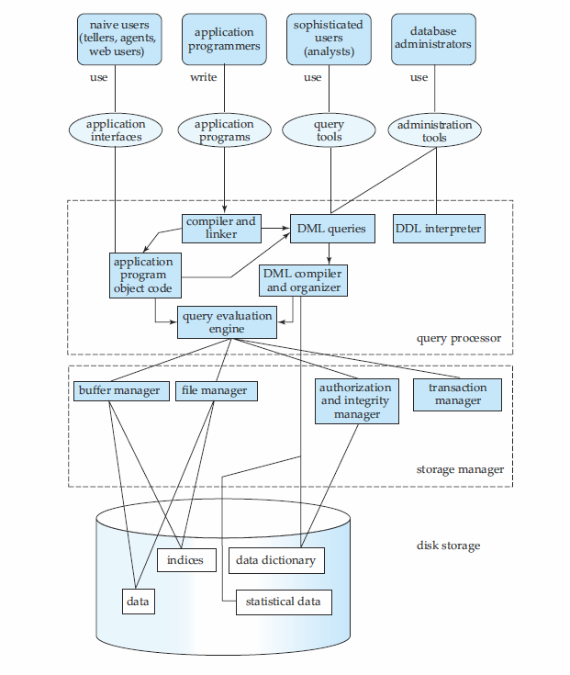
Overall System Structure

Slide 44
Database Architecture
Centralized databases
One to a few cores, shared memory
Client-server,
One server machine executes work on behalf of multiple client machines.
Parallel databases
Many core shared memory
Shared disk
Shared nothing
Distributed databases
Geographical distribution
Schema/data heterogeneity
Notes:
44

